Slide 1
The Wonderful World of Food
A Tasty Journey

Slide 2
History and Evolution of Food
- Hunter-Gatherer Era: Foraging for food and early culinary practices.
- Agricultural Revolution: Domesticating plants and animals for food.
- Industrialization: Mass production and global food trade.
- Modern Trends: Health consciousness, sustainability, and culinary innovation.

Slide 3
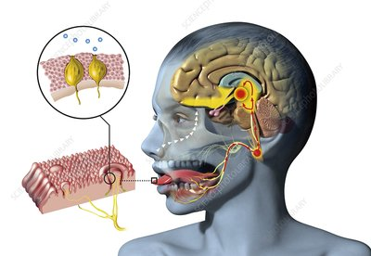
The Science of Taste and Flavor
- Our senses of taste and smell are crucial to our perception of food.
- Taste buds detect sweet, sour, salty, bitter, and umami flavors.
- The complex interplay of aromas and flavors creates unique culinary experiences.

Slide 4
Food as a Cultural Ambassador
- Food tells a story about a region's history, traditions, and values.
- Examples:
- Italian pizza and pasta
- Indian curry and spices
- French cheese and wine
- Culinary diplomacy: Using food to build cultural bridges and foster international relations.

Slide 5
Sustainable and Ethical Eating
- Environmental Impact: Considering the ecological footprint of food production.
- Local and Seasonal Eating: Reducing food miles and supporting local farmers.
- Plant-Based Diets: Exploring vegetarian and vegan options for health and sustainability.
- Food Waste Reduction: Strategies to minimize waste and maximize resource use.

Slide 6
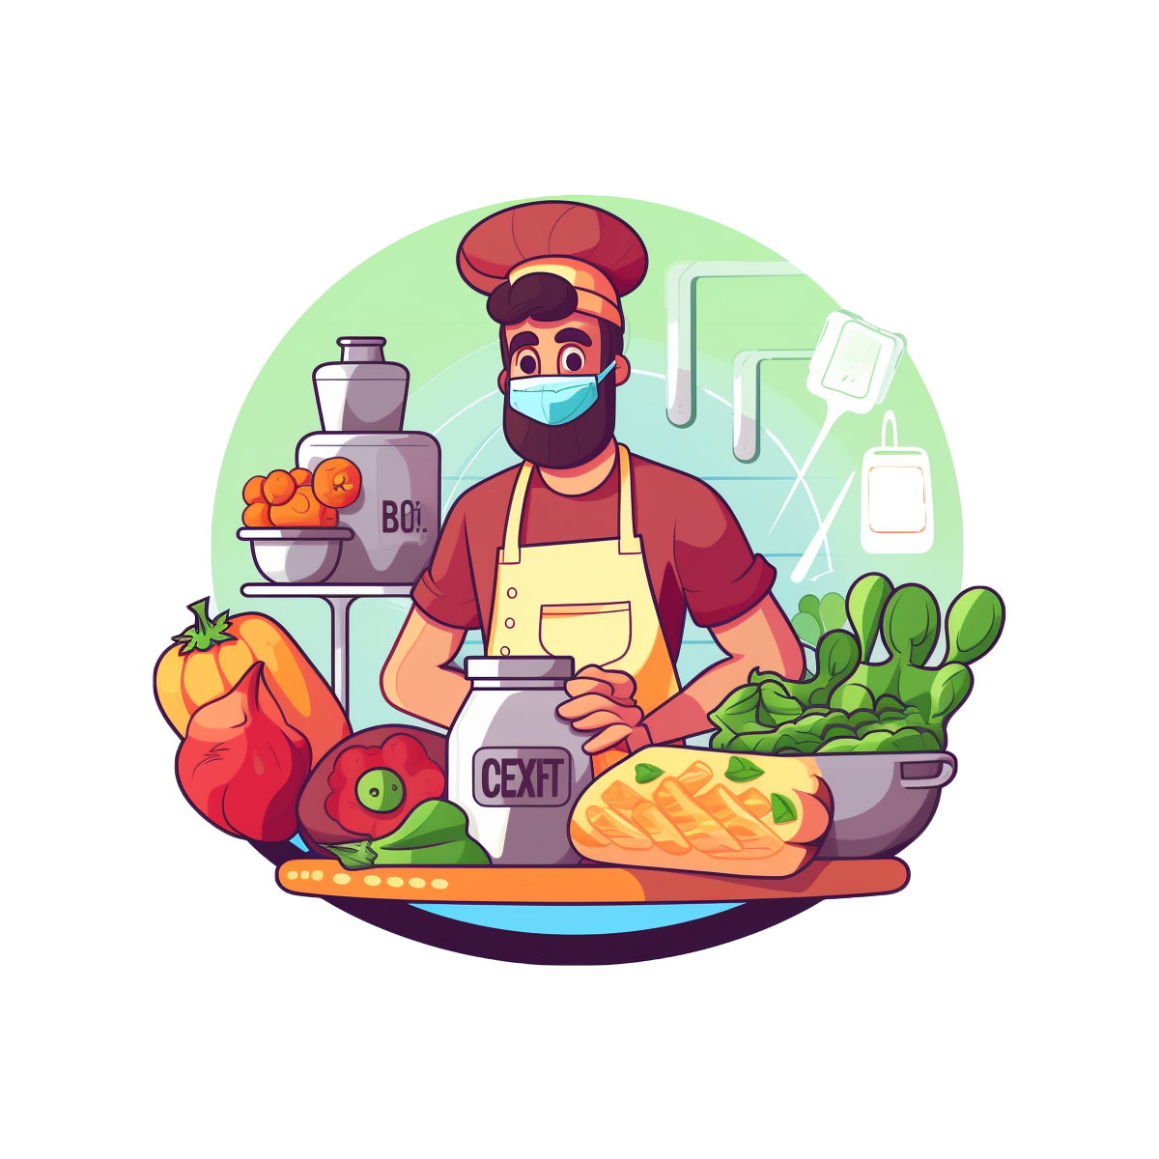
The Art of Cooking
- Cooking is a creative process that transforms ingredients into delicious dishes.
- Techniques: From roasting and braising to sautéing and baking.
- Culinary Arts: The study and practice of cooking as a skilled craft.

Slide 7
Food and Health
- Nutrition: Understanding the role of macronutrients and micronutrients in our diets.
- Balanced Diet: Incorporating a variety of foods for optimal health.
- Food as Medicine: Exploring the healing powers of certain foods and dietary approaches.
- Dietary Restrictions: Accommodating allergies, intolerances, and lifestyle choices.

Slide 8
Food Innovation and Technology
- Food Science: Developing new products, improving safety, and enhancing nutrition.
- Agriculture Technology: Innovative farming methods for higher yields and sustainability.
- Food Delivery and Convenience: The rise of meal kits, online grocery shopping, and food delivery apps.
- Future Trends: Lab-grown meat, 3D-printed food, and personalized nutrition.

Slide 9
Summary
- Food is a fascinating and multifaceted topic that touches all aspects of human life.
- We've explored the history, culture, science, and future of food.
- By understanding food better, we can make more informed choices and appreciate the delights it brings to our lives.

Slide 10
Next Steps
- Explore local food producers and farmers' markets to support sustainable practices.
- Experiment with new cuisines and flavors to broaden your culinary horizons.
- Stay informed about food trends and innovations, considering their potential impact on your life and the planet.

Slide 11
Bon Appétit!

Slide 12
Summary
This presentation provided an overview of 'food', highlighting the most important points and insights.

Slide 13
Next Steps
1. Review and customize the slides.
2. Add supporting data or visuals.
3. Rehearse your delivery.

Slide 14
Thank You!

